Slide 1
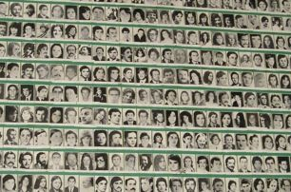
Human Rights in Argentina:
From Dictatorship to Democracy
Georgia State University
Study Abroad
Maymester 2023

Slide 2
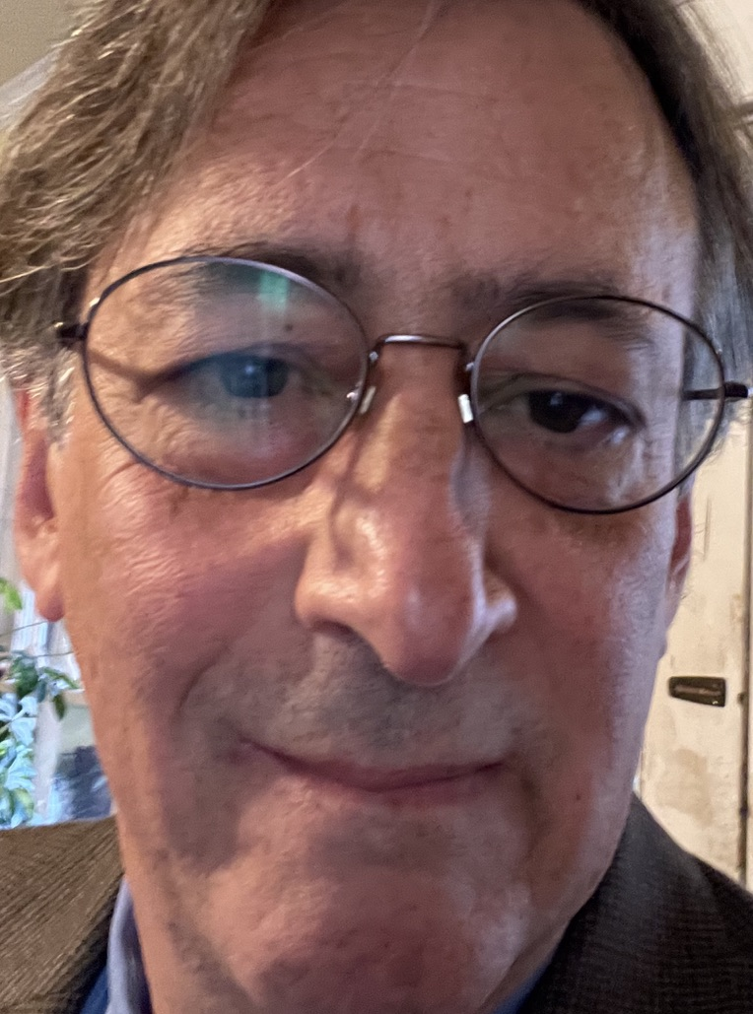
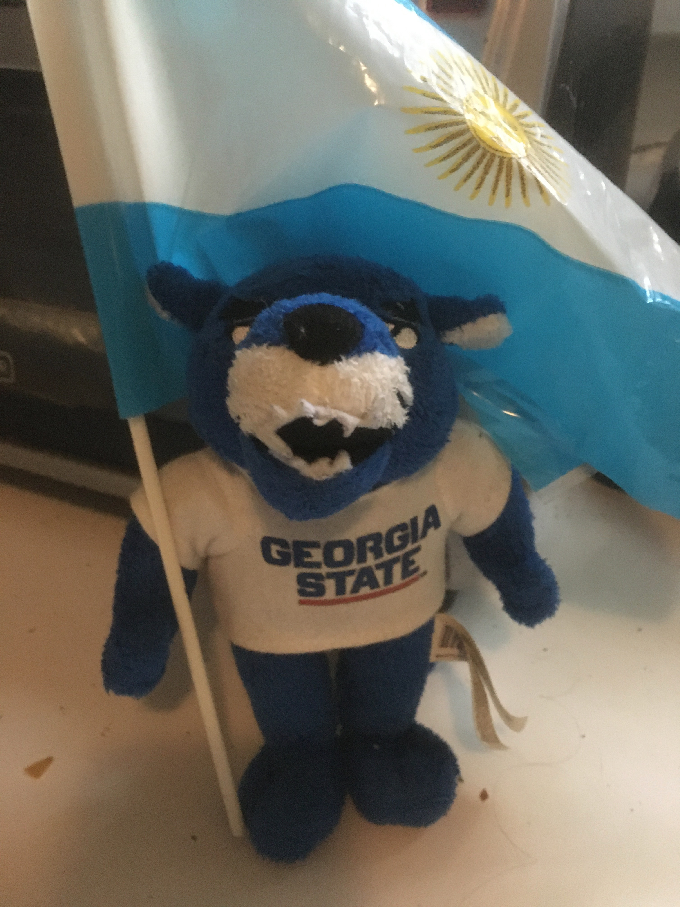
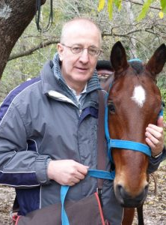
Who is leading this program?
Cruise Director:
Pochito La Pantera
Major Undeclared
Program Director:
Gabriel Kuperminc
Dept of Psychology
gkuperminc@gsu.edu
Co-Director:
Fernando Reati
World Languages and Cultures
freati@gsu.edu

Slide 3
Who can participate?
Undergraduate and graduate students
Psychology
Literature/culture concentration of the Department of World Languages and Cultures
Students pursuing a certificate in Latin American Studies through the Center for Latin American and Latino Studies.
Also, students in departments such as Anthropology, History, Philosophy, Political Science, Sociology, or Gender Studies
Any students who have an interest in international approaches within their disciplines.

Slide 4
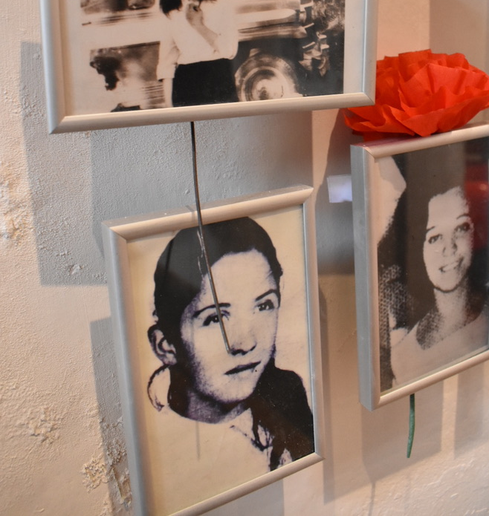
Academics
Undergraduate
PSYC 3901, PSYC3901H – Study Abroad in Psychology, 3 credit hours
SPAN 3395, SPAN 3395H- Study Abroad, 3 credit hours
Graduate
PSYC 6650 – Psychology: Special Topics, 3 credit hours

Slide 5
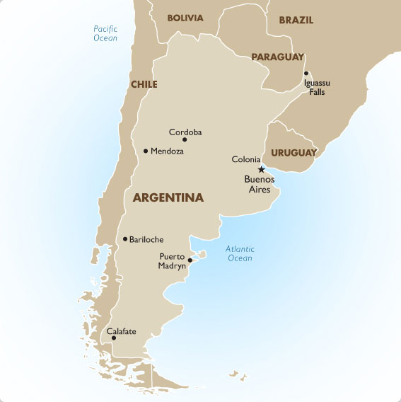
When and How are we going?
May 11: Depart Atlanta
Overnight flight
May 12: Arrive in Córdoba
May 22: Bus trip to Buenos Aires
May 25: National Independence Holiday
May 29: Depart for Atlanta
May 30: Back home!

Slide 6
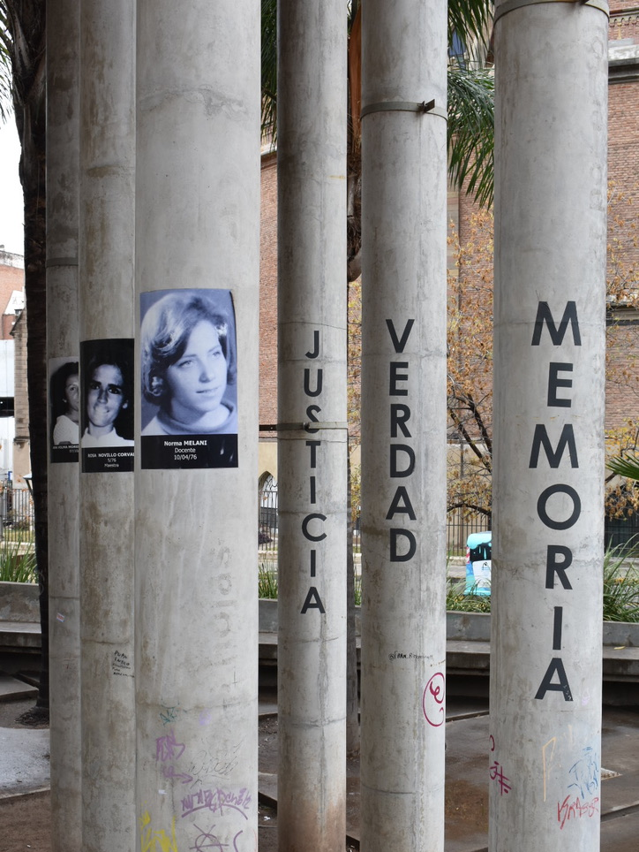
Argentina’s “Dirty War” 1976-83
Period of state terror during which as many as 30,000 Argentine citizens were “disappeared” and subsequently tortured and murdered by their own government.

Slide 7
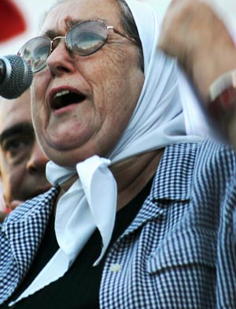
The Program
Experiential Learning!
Field trips to memorial sites
Meeting human rights activists
Background lectures
Group discussion and debrief sessions
Documentary and Blogging Project
Cultural Immersion
Visit historic sites dating back to the Jesuits’ arrival in Argentina
Hiking and horseback riding in the Sierras
Cafes, restaurants, and tango halls in Córdoba and Buenos Aires

Slide 8
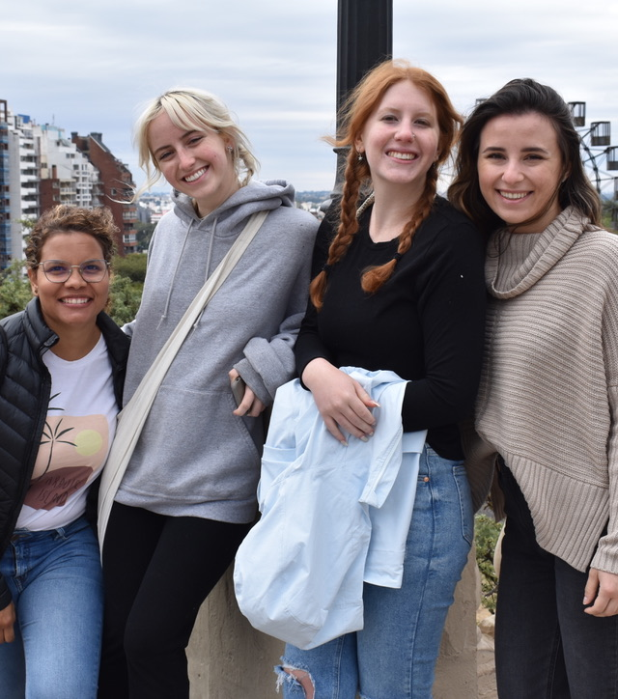
Highlights
May 11 – 22 Córdoba
Argentina’s 2nd Largest city
Industrial/Educational Center (Oldest university in Argentina) with history of activism
Large number of disappeared
Nestled in foothills of the Argentine Sierras
May 25 National Independence Holiday
May 25-31 Buenos Aires
National Capital and largest city
Largest and most notorious ex-detention centers for disappeared citizens during the state terror
Home of the tango, great food, coffee, and wine

Slide 9
Nuts and Bolts
Program fee: $2,300
Program fees cover
Double occupancy hotel room, breakfast included
Entry fees, tours & excursions, local transportation
Some meals and activities
Insurance
Not covered
GSU tuition and fees
Airfare
‘On your own’ meals and personal expenses
Passport, baggage fees, etc.

Slide 10
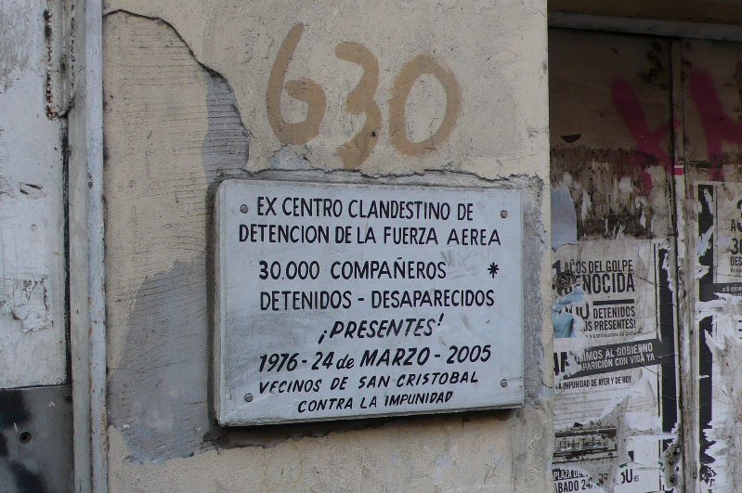
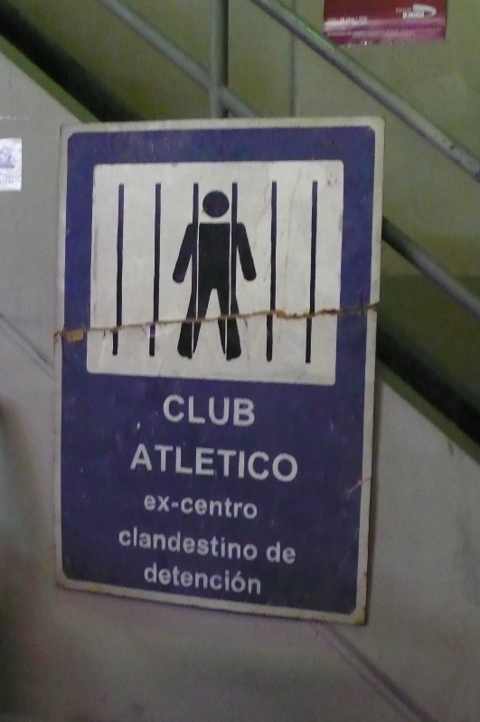
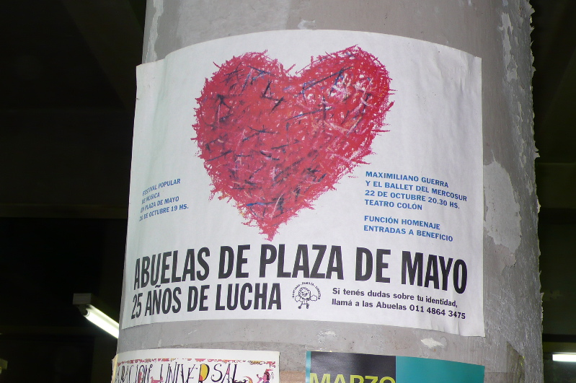
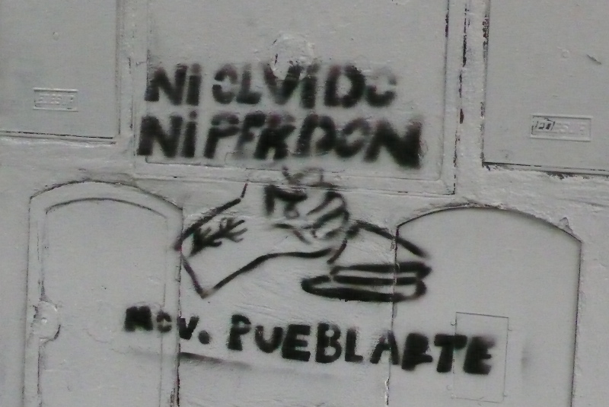
Everywhere you look – reminders of human rights

Slide 11
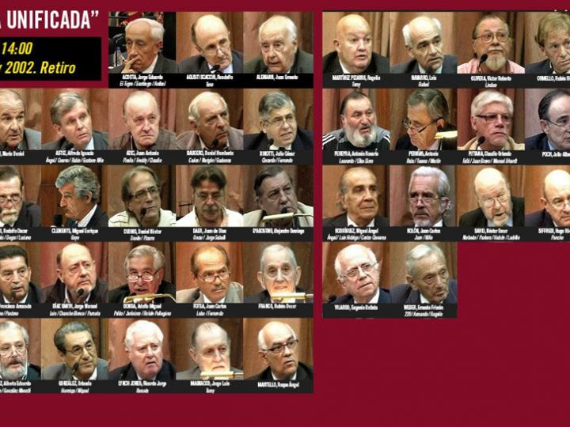
40 Years after the Dictatorship
Unanswered questions
Changing public opinion and official policy
Ongoing activism and human rights advocacy
Memoria, Verdad, y Justicia!
Ongoing trials of repressors

Slide 12
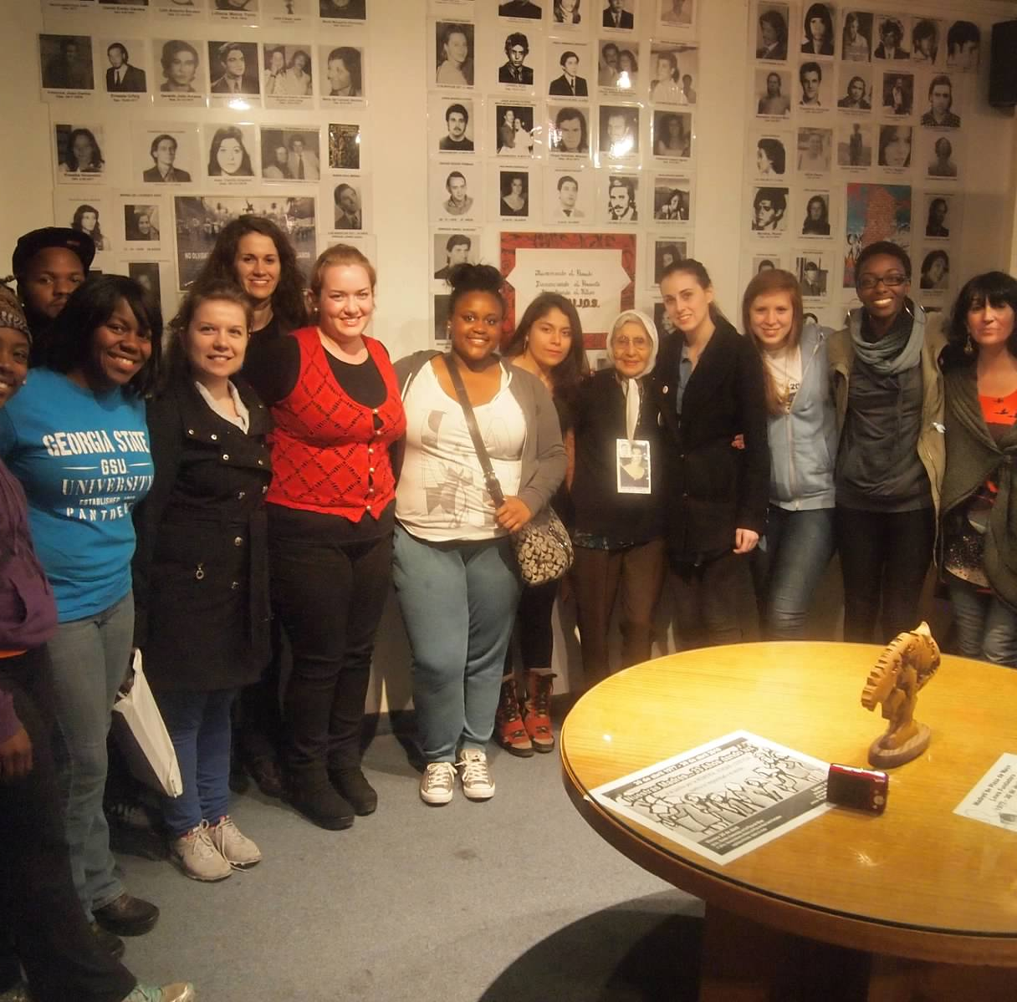
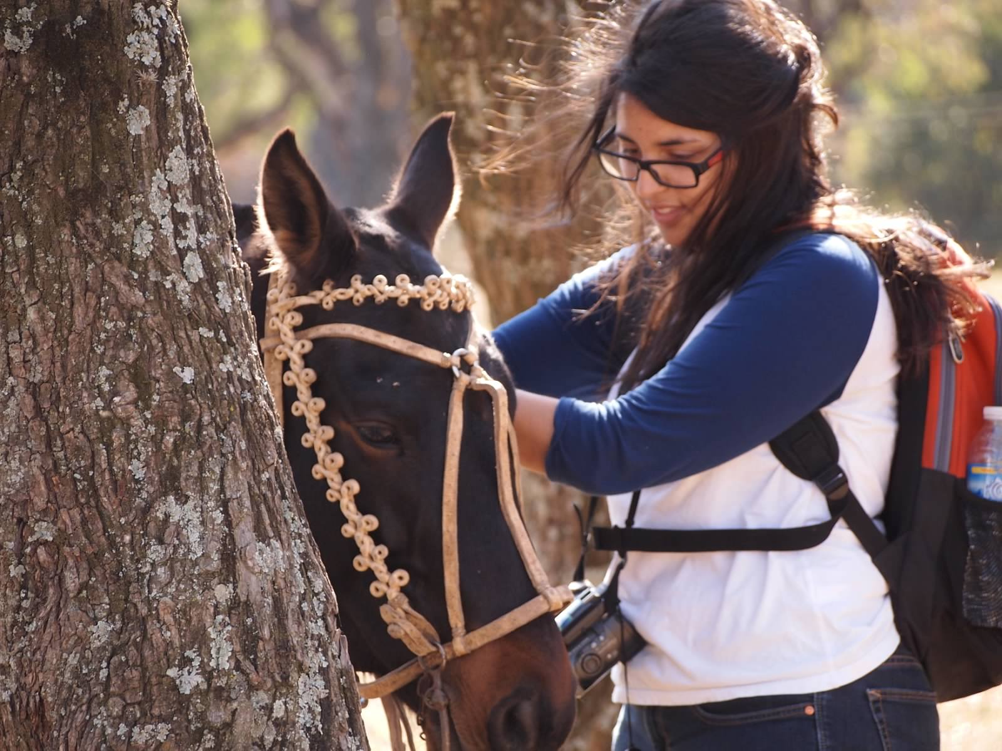
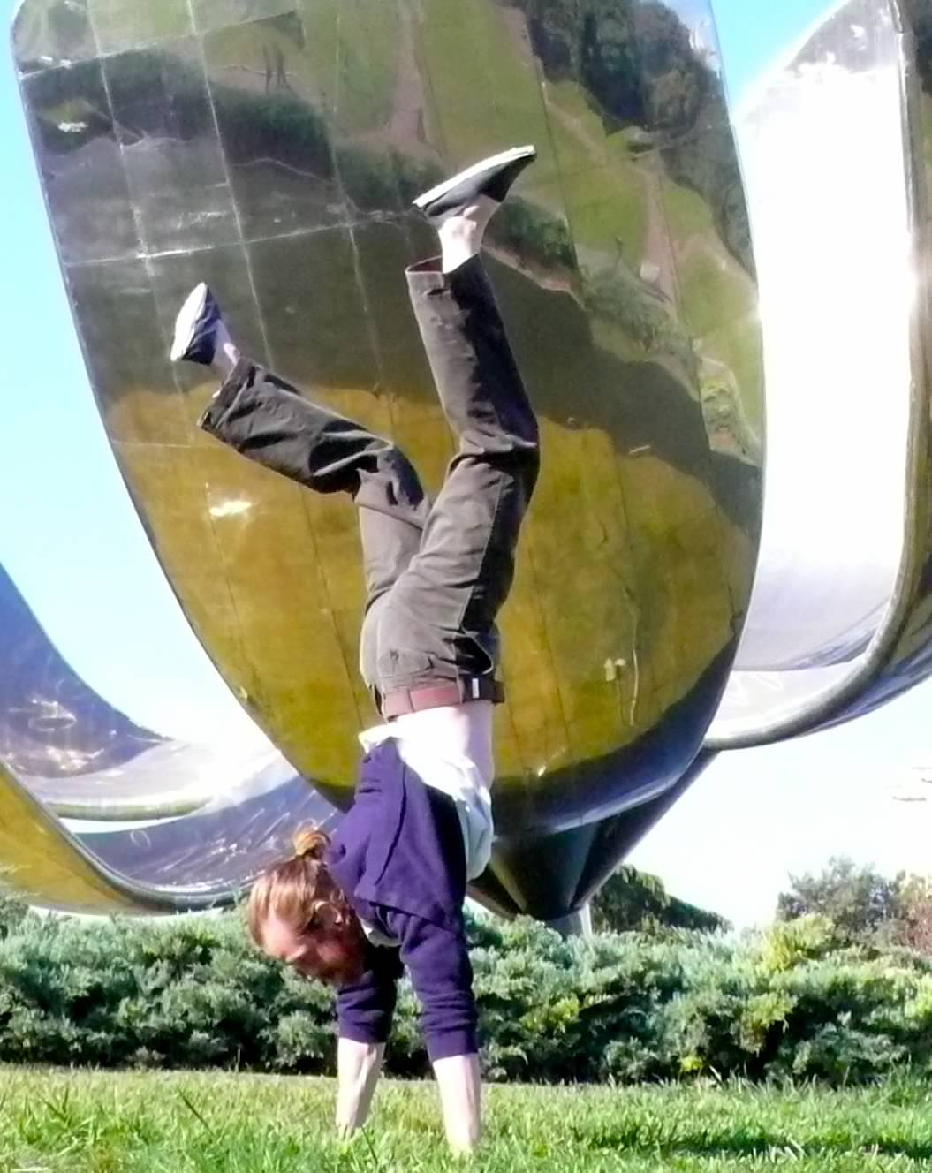
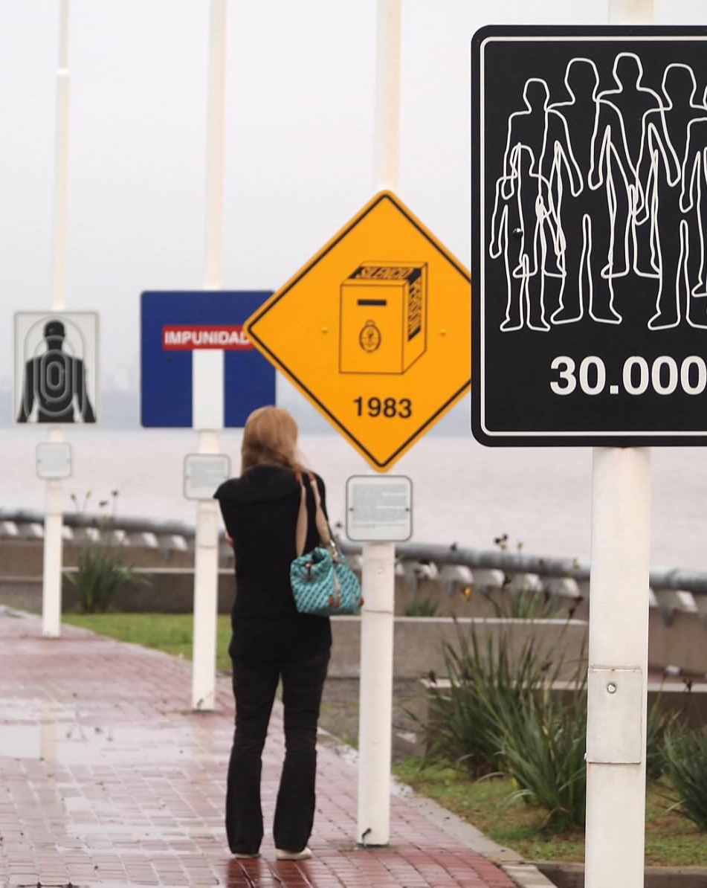
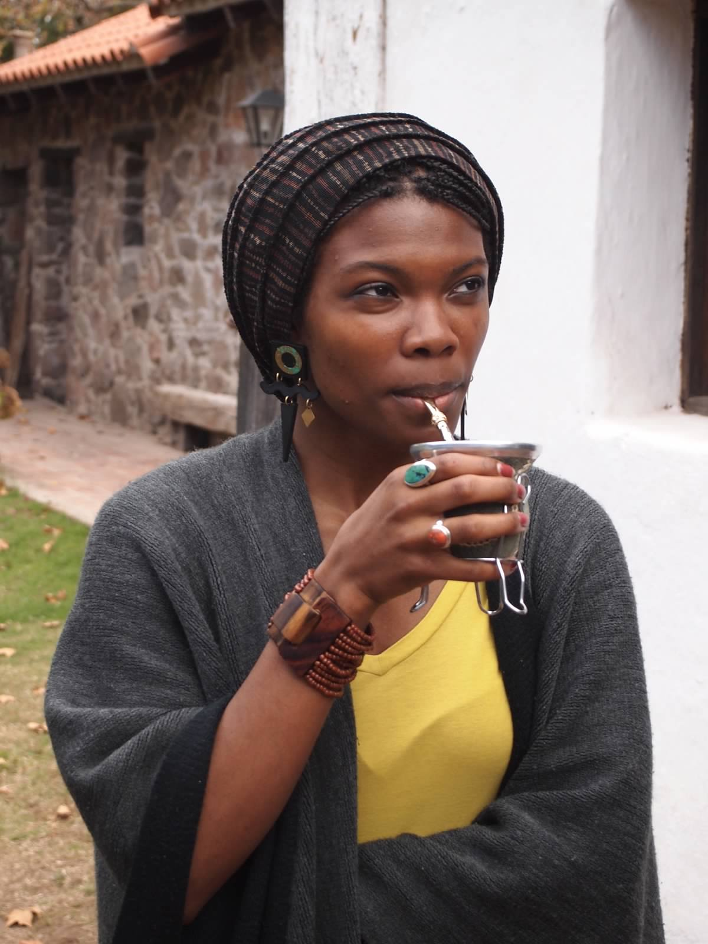

Slide 13
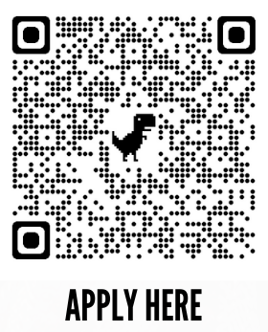
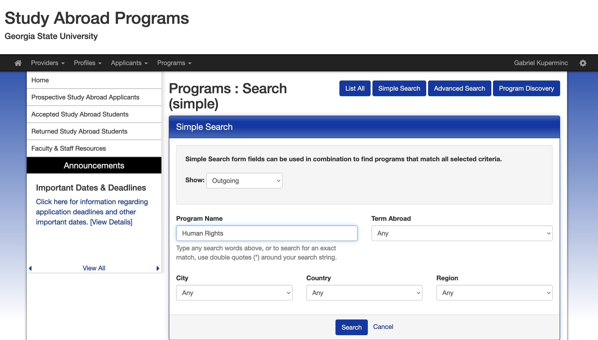
How to Apply
Go to myStudyAbroad.gsu.edu or use the QR Code and click Search Programs
THEN
Either enter the program name (or part of the name) or the country, i.e.,“Argentina”

Slide 14
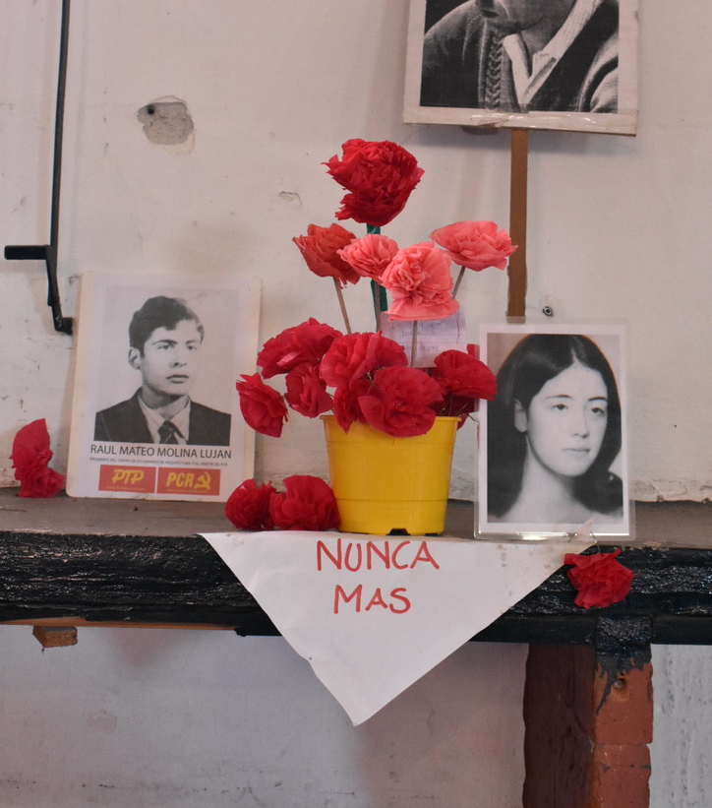
Contact Information
Program Director:
Gabriel Kuperminc
gkuperminc@gsu.edu

Slide 15
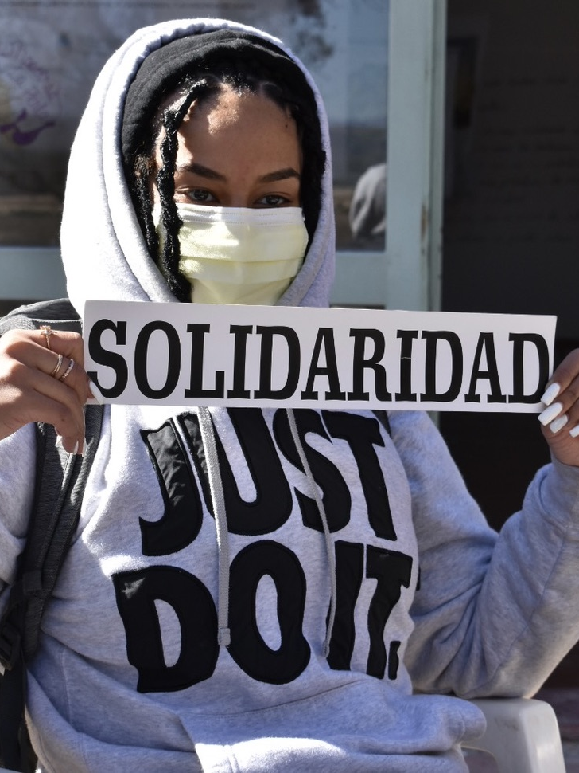
For more information
Check our our website:
https://sites.gsu.edu/gsu-hr-in-argentina/
Follow us on Facebook: https://www.facebook.com/GSUHRARGENTINA/
Sign up for an interview:
https://bit.ly/Interview_Argentina

Slide 16
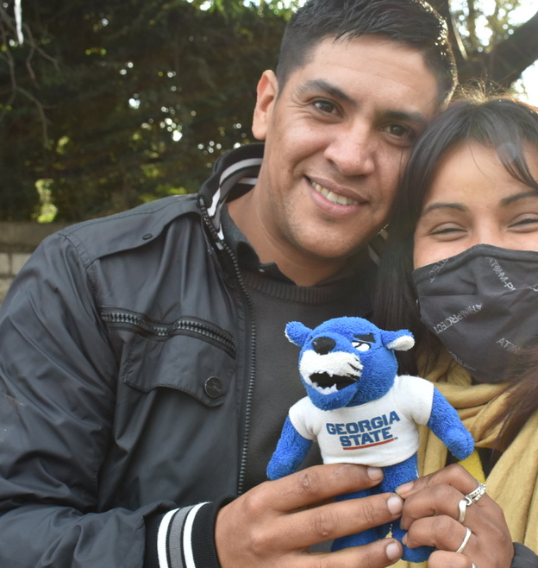
¡Gracias!

